Slide 1


Spotlight on Trip Opportunity 2028

Slide 2


Slide 3
Welcome to
Ormiston SWB Academy
Year 6 Induction Evening
July 2026

Slide 4

Please take one of our heritage books that shows the history of SWB Academy.
They can be collected from the table next to the uniform on Brindley Floor

Slide 5
Key Personnel
Mr Morgan – Assistant Principal
Mrs Sira – Director of year 7 (academic lead)
Mrs Blakeman – Pastoral support
Miss Kiely - SENDCO

Slide 6
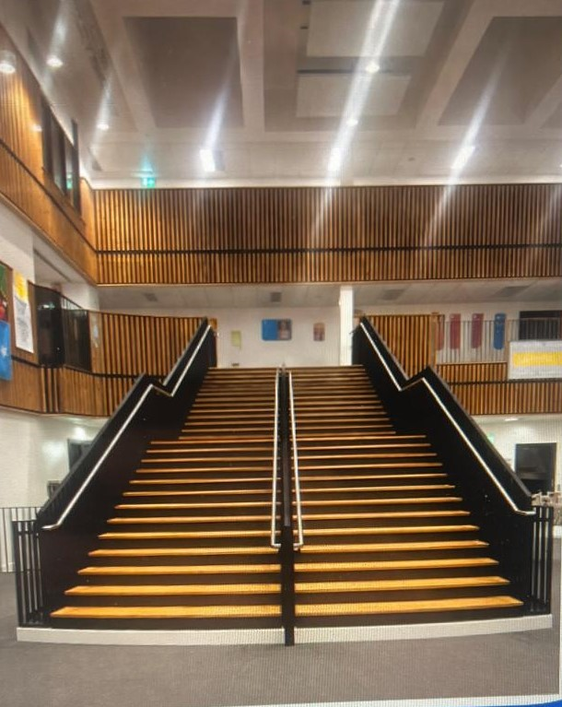
348 pupils (459 in total) wanted to be sat here in September, but you are the 230 who have got a place.
The information you receive this evening is vital if you wish to maximise your time here

Slide 7
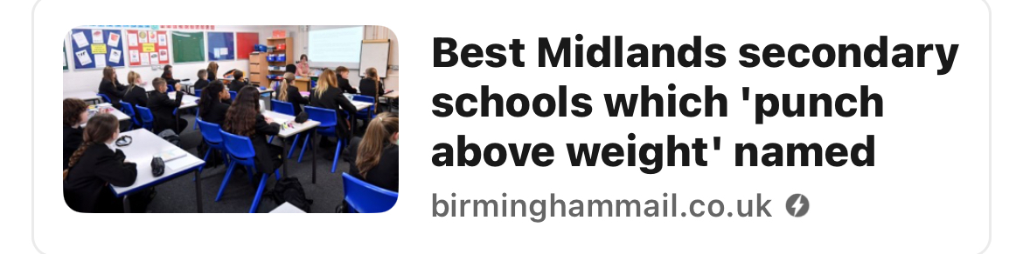
2025 results
We received record results last year in the history of the Academy, with 61% gaining a grade 4 in English and Maths.
It also placed us 4th in the City of Wolverhampton

Slide 8
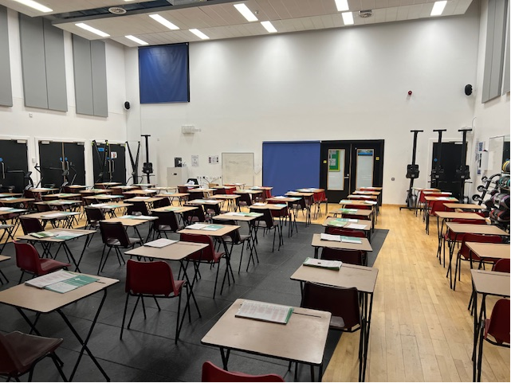
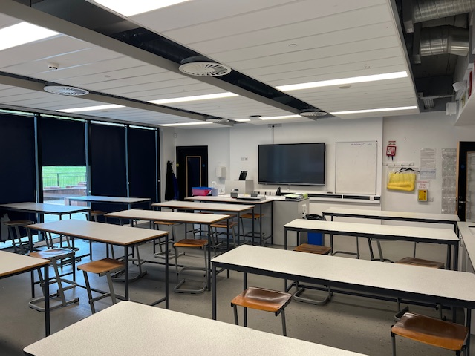
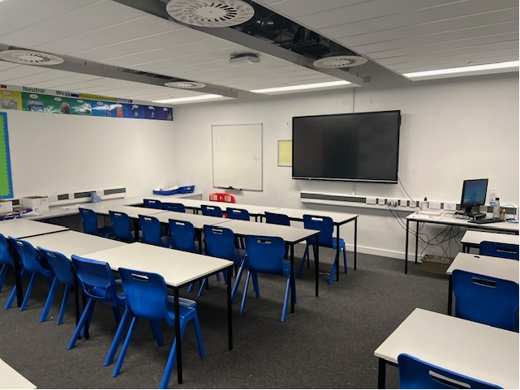
This was really successful with our Year 7 pupils in the past 2 years. Our new Year 7s will do this for the first month only
September 2026

Slide 9
Procedures and Sanctions to support students
If a student disturbs the learning in a classroom…
or does not meet our CORE expectations
Student will be given a reminder to change their behaviour or they will be given a sanction
S1 - this will be recorded on Class Charts but students will not have to stay for detention
S2 - 30 minute detention
‘Lesson removal’. Moved to REFLECT room ( Lesson removal) + after school 60 minute detention
S3 – 60 minute detention
Internal Suspension: all day ( 5 periods plus lunch, break and 60 minute after school detention)
Suspension
ALL SANCTIONS ARE THE SAME DAY. In exceptional circumstances parents can email in if a student cannot attend but this MUST be by the same day - the detention may be re-arranged. Other wise - students are expected to attend.

Slide 10
Procedures and Sanctions to support students
Possession of an offensive weapon = Permanent Exclusion
Possession of drugs = Permanent Exclusion
Assaulting staff = Permanent Exclusion
Persistent disruptive behaviour = Permanent Exclusion
Permanent Exclusion = Student loses their place at SWB permanently

Slide 11
Special Educational needs/disabilities
We are fully aware that some students have additional needs.
  There are 7 trained SENDCO's in this building (most schools have 1)
By law reasonable adjustments are applied in line with the additional needs a child has.
  That does not mean a child with additional needs is exempt
  from sanctions though. The transparency of the rules makes
  it easier for children with needs to function
We are highly inclusive and SEND has a high priority within the academy where quality first teaching is expected for all. This is done through Provision mapping, curriculum reviews and quality assurance from our SEND team

Slide 12
How can you help?
Ask questions about what they have done at the academy - Check on Class Charts. Make sure you are familiar with the policies and expectations - these will not be changed and are not negotiable.
Expect your child to attend every day – encourage this expectation
Homework – Check on Class Charts and ensure your child completes it within the time frame
Read all text alerts immediately and check the website
Follow us on Tiktok, Facebook & Instagram

Slide 13
How can you help?
Inform us of any concerns/changes regarding your child and communicate with us regularly - communication is an essential part of our partnership
Keep us updated with any phone number or email changes
Attend all meetings and parents evenings
Appropriate conduct towards staff – we will seek to ban parents who abuse staff
Positive relationships in front of your child – even if you do not agree

Slide 14
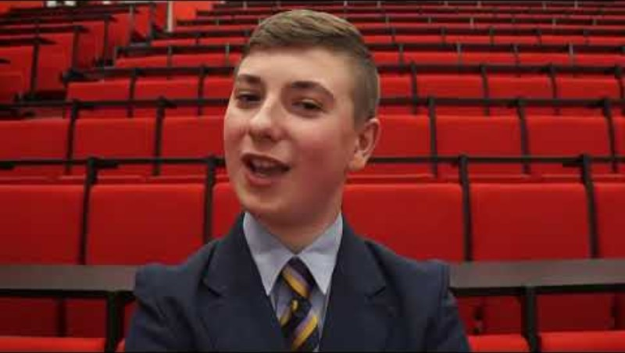
Uniform

Slide 15
Uniform
Academy trousers must be black, a tailored formal style​ and have a zip / pockets
No leggings, jeggings, jeans or cords
Official academy skirt with SWB logo​ - this MUST be knee length. If they are rolled up continually - parents will be asked for children to wear trousers
Shoes must be plain black and formal (no trainers, no Nike Air Force, no plimsolls)
​
In the summer term only
Optional Polo shirts with SWB logo can be purchased

Slide 16
Uniform
No extreme haircuts (No tram lines or circles)
ONLY natural hair colours – no non natural dyes or colouring
No nails above the finger tips
No extreme eyelashes​
One pair of small stud earrings ( no lower than the ear lobe) – no other piercings​
No coats or hats inside (Lockers are available)​

Slide 17
Uniform
“How does uniform affect learning”
Parental support is essential
You have opted to join us and be here tonight
When your child becomes 13/14, it will become much tougher* (social media, TikTok and other peer pressures, influencers, etc)
Uniform is non negotiable and the academy reserves the right to determine what constitutes none natural, extreme, etc.
* We have found that this is when parents sometimes are far less supportive

Slide 18
Toilets
Students are expected to go to the toilet during movement time ( 5 minutes at each change over), break or lunchtime.
Students are not allowed to go to the toilet during lessons (unless they have a medical/ physical condition that evidences this need)
Toilet areas are supervised to ensure student safety and appropriate use of toilets

Slide 19
The rules are non negotiable
X
I won’t apologise for having high expectations for your children
These will be a key driver in your child leaving SWB with the outcomes and skills to transition to the next chapter of their life

Slide 20
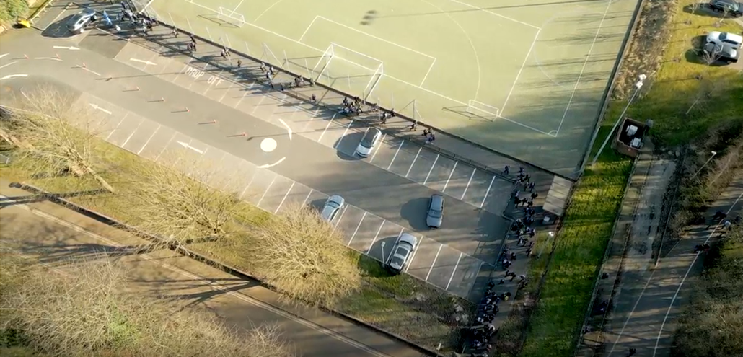
Pupil drop off and collection
There is very limited parking on Prosser Street, so parents may wish to look at alternatives when dropping off their children. The car park gates open at 8.10 each morning, with pupils able to enter at 8.20. These are then shut for the day at 8.35. Students arriving after 8.35 will have to enter via reception and are likely to be classed as late to school.
At the end of the day, the gates will not open until 3.05 so parents should not arrive before this time. We also ask parents/carers to be respectful to the nearby residents in ensuring they are not blocking any access or parking in the lane adjacent to the car park that has double yellow lines.

Slide 21
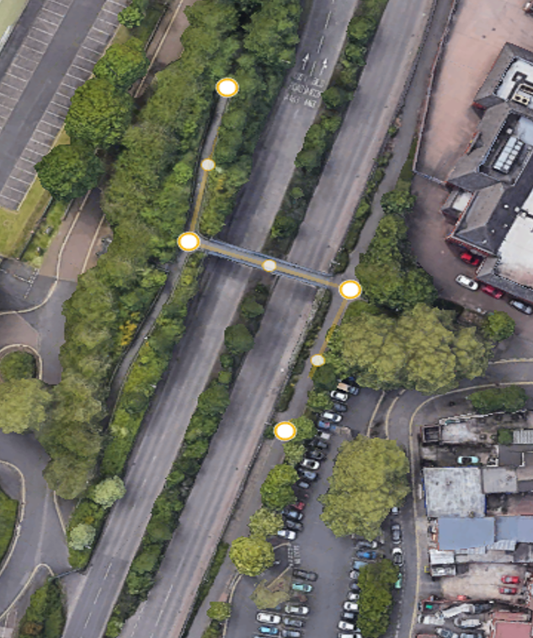
Parental expectations
Entrance and exit
Pinfold Street car park
400 yds from the gate
Staff supervision at gates, top of the ramp/flyover
Huge reduction in congestion for the community

Slide 22
Parental expectations
When a parental meeting occurs, the pupil will wait outside initially. This is the point to raise your concern with the staff. When the child is in attendance, their needs to be a united front in trying to bring about the best for the child. ‘Belittling’ or being ‘oppositional’ towards our staff completely undermines the authority a school has. You may not agree with all of the school rules, but you should support them if you are choosing to send your child here to SWB.
As human beings, we will all make mistakes. If/when this happens, sharing these over social media doesn’t help anyone, especially before they have been looked into. Please ensure you contact us and discuss through the correct channels.
Anyone making defamatory remarks will be asked to remove them.

Slide 23
Expected conduct – explicit not extreme
We ‘show’ not ‘tell’.
The expectations are made very clear to our students.
These are done through videos and through practice each term as well as regular reminders throughout the year.
You will soon be able to see a document called ‘A day in the life of an SWB student’, which will be sent to you over the holidays. This shows the expected conduct both in and outside of the academy, such as when at the bus station, crossing the road, riding bikes to school, etc
Please be aware that the law means the school rules apply outside of the school gates too, whether students have uniform on or not. In they are identifiable as academy students – they will be sanctioned.
This is something that Year 7 students struggle to comprehend each year when informed.

Slide 24
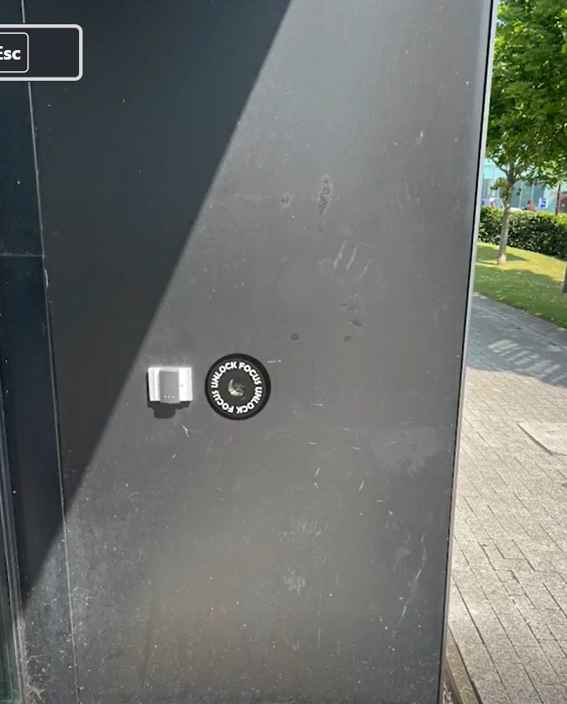
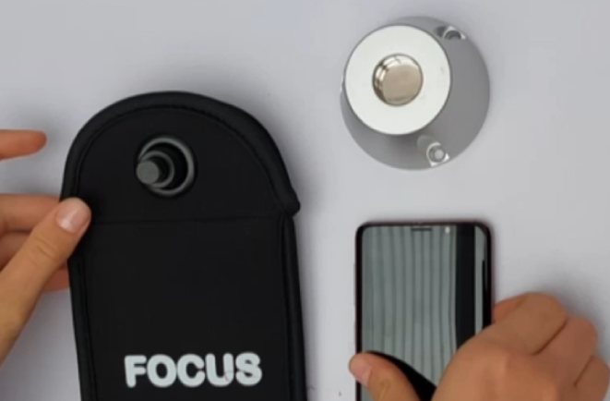

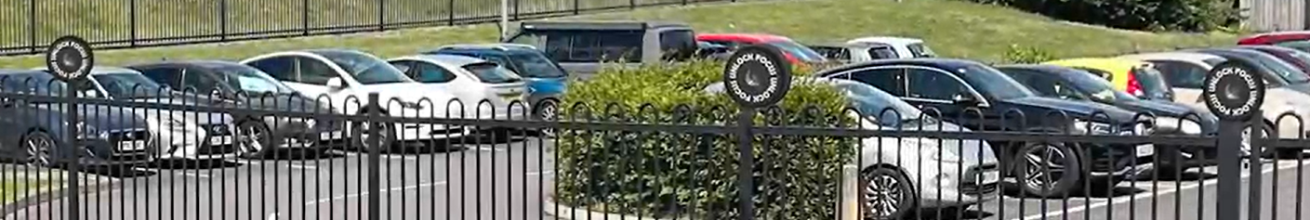
Mobile phones
Mobile Phones are a prohibited item at Ormiston SWB Academy (and legally too). Pupils will be given a mobile phone pouch which is yours to keep. If you decide to bring a phone to school, it is placed in the pouch on entry to the academy and locked. This will be checked by tutors each morning as it is placed on the equipment mat
Upon leaving the academy, you can use any of the multiple unlocking devices we have at the academy exit point (shown below

Slide 25
Rewards
Weekly Ice Cream rewards regarding attendance
Termly golden ticket draws
Termly achievement ceremonies to reward and recognise pupil efforts

Slide 26
Our CORE offer
We have the following value at SWB:
C - Character
O - Organisation
R - Resilience
E - Excellence
To support these, all of our pupils have a CORE lesson, where they are taught about issues outside of the National Curriculum subjects. This could be matters such as:
E safety
Sex Education
Knowing the dangers of exploitation
Financial management
Careers education

Slide 27

Our CORE offer
In addition to this, we have 5 CORE days per year, with some being off site.
Full information on our website under curriculum
If you were to be with us for 7 years, you would visit some of the following places during the school day:
London
A beach
A museum
A university
A castle
Travel on Public Transport to Birmingham

Slide 28
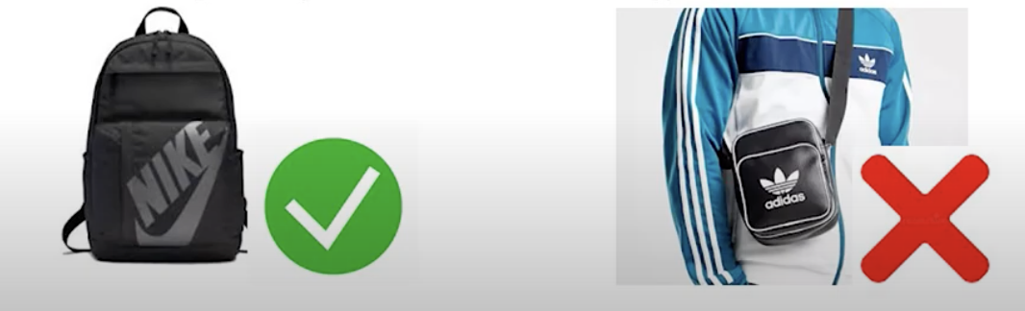
Essential Equipment Needed
Bag (large enough for an A4 folder)
Pencil case
Black pen and green pen
Pencil
Ruler
Reading book (Available from our library)
Knowledge Organiser
Phone pouch

Slide 29

How can you help?
Energy drinks are banned. They will be confiscated and disposed of.

Slide 30
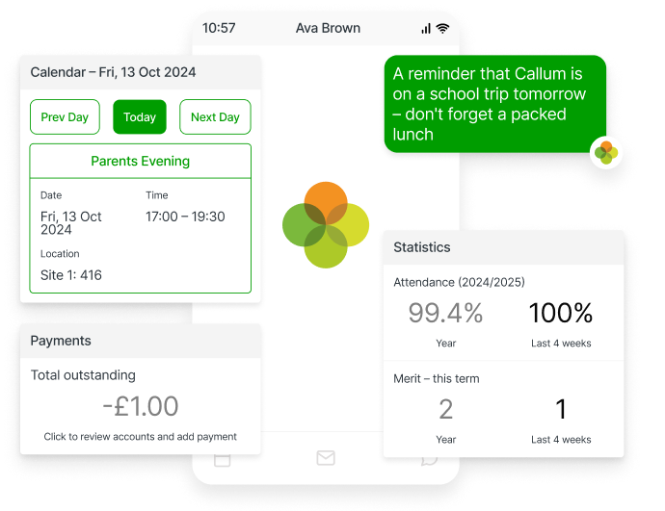
Arbor
As your child prepares to join Ormiston SWB Academy this September, we would like to introduce you to Arbor, our Management Information System, and the Arbor Parent Portal and Parent App, which we use to keep parents informed and connected with academy life.
The Arbor Parent App is available to download from both the Apple App Store and Google Play Store and provides a convenient way to manage important information about your child throughout their time at the academy.
The Arbor Parent Portal and App gives you access to a range of features designed to make communication and administration easier including; ​
Attendance ​
Payments and Balances ​
Student Information ​
Communication

Slide 31
Biometric system and Arbor Pay
By using the Arbor Parent Portal/App, parent/carers can update student account balances meaning there is no need to bring cash into the academy
However, those who wish to pay by cash can do so via the revalve machines in the Restaurant.
Additionally, pupils can use the 'finger' to add cash to the revalve machines or pay for items at the till.

Slide 32
Online Admission forms
To date we are 99 admissions forms outstanding
The admission forms need to be completed as a matter of urgency. We need these forms to be completed prior to students starting.
This evening, we have staff in B9 on hand to help parents complete the forms this evening.

Slide 33
Rank Order
This is an initiative that was launched this year – most successful schools do this
It is anonymous (other than celebrating the top performers). The only way anyone can see your pupils performance is if they share their unique code
There is a Half termly reveal for attendance, behaviour ratio, homework completion – all things that are in control of the student/family
Half yearly reveal – academic performance is added (weighted against the monthly).
By doing this, we can really focus in on the area of development for the child

Slide 34
Rank Order
One of our CORE values is ‘Resilience’. Our pupils need to be aware that they will and already are being ‘ranked’ in numerous ways in their lives:
whether this be in a college application
Job interview
Playing for a sports team
Or more recently on how they did in their SATS
I appreciate that some of you may not be in favour of this. If this is the case, you can opt out of this process and your child’s unique code will not be displayed. To do this, you need to contact us via the email below stating your childs name and DOB.
rankorder@oswba.co.uk

Slide 35


Slide 36
Thank you for listening
Have a wonderful and safe summer!
First day back for Year 7
Wednesday 2nd September 2026
Arrival - 0820

