Slide 1
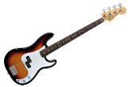
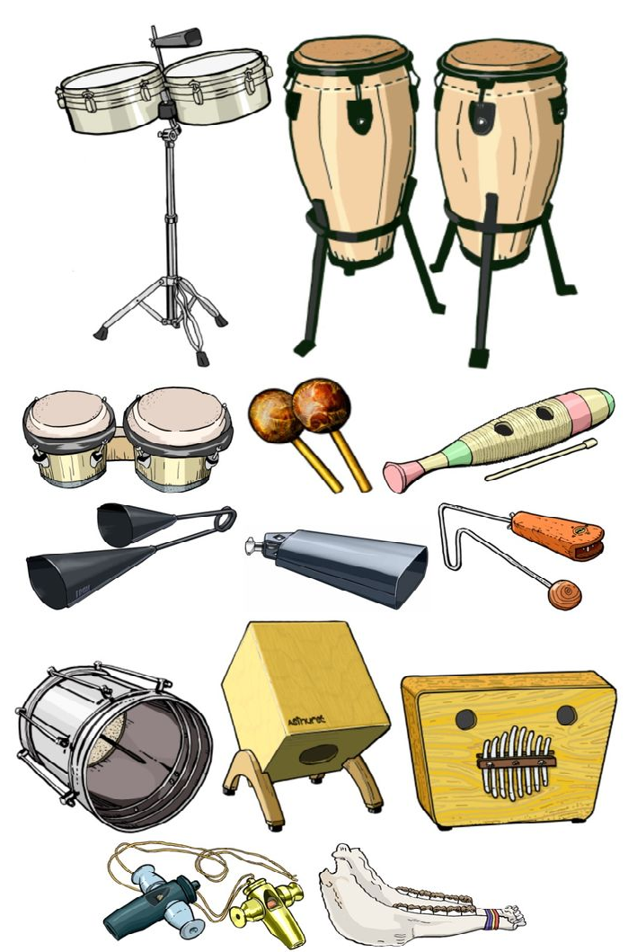
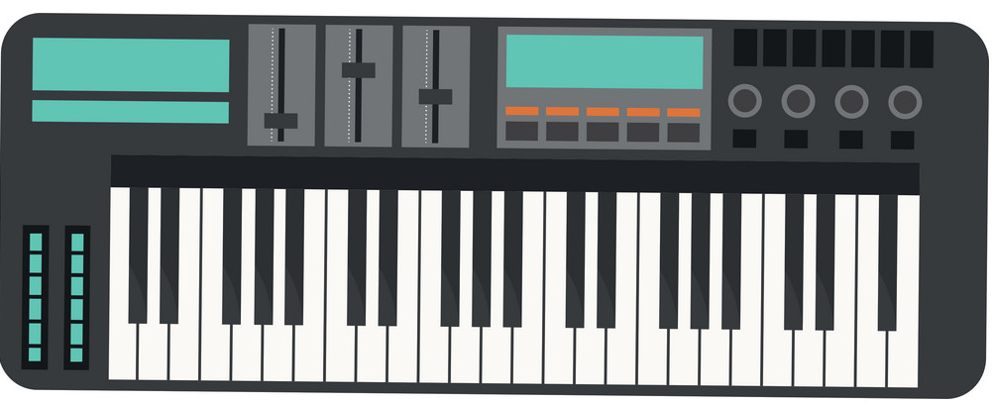
Apply skills and techniques
in a music performance,
creation or production.
Music Learning Journey
Component 3: Responding to a commercial Music Brief
Explore the brief
and develop
possible responses and ideas.
Reflect on your progress,
and on areas for improvement.
Year
11
Component 3
Present your
final response
(solo or
in a group).
Use relevant resources,
Skills and techniques
to develop and refine musical material.
Take part in practical
workshops to understand
stylistic features and
characteristics.
Component 2:
Music Skills Development
Explore different
styles and genres
of music.
Develop a range of skills
Component 1
Component 2
Choose an area of the industry
that excites you
(composer, performer, or producer).
Review and reflect on
your approach to the
brief and your final outcome.
Learn about the different
products the music industry.
Component 1: Exploring Music Products & Styles
Develop
instrumental
Techniques.
Year
10
Understand the difference between major and minor
Leitmotif and theme
Bob Marley
Influence of technology on music
Dancing Queen
Dissonance
Dance Music/EDM
Film Music
REGGAE MUSIC
Perform popular tunes on Ukulele, Keyboard or Guitar
Soundtrack and
Sound Effect
Rastafarianism
Syncopation 2nd and 4th beat
Just Play
How lighting, scenery, acting, singing, make up and dancing influences Musical Theatre
Understand the difference between major and minor
Identify key features of Samba Music
Performing as an Ensemble
Latin-American
Percussion
Soundtrack and
Sound Effect
Leitmotif and theme
Year
9
Cyclic and Polyrhythms
Film Music
Samba Music
Musical Theatre
Improvisation
Texture and Layers
Syncopation
Melody and Chords
Treble Clef Staff Notation
Effective Keyboard Performance Technique
Chord sequence
12 bar blues
Hamilton rap
The Blues
Just Play
Slavery
Perform popular tunes on Ukulele, Keyboard or Guitar
Listening test
Listening to a range of Classical Music
Viva La Vida class performance
Graphic Scores
Treasure Island composition
Notation
Melody and Chords
Treble Clef Staff Notation
Year
8
Descriptive Music
Time Keeping 2
Listening test
Rhythm Grid Notation
Instruments of the Orchestra
Listening, Performing & Composing
The Elements of Music
Pulse/Beat
Just Play
TIME KEEPING 1
Year
7
Strings, Woodwind, Brass and Percussion
Perform popular tunes on Ukulele, Keyboard or Guitar
Identify instruments and crotchet beats and rests
Identify musical elements

